Slide 1

Versions
Current Version:2.2.0
Version Used: 1.2.1
-

Slide 2
Agenda
Topics
Hive Background
Hive - Introduction
What is Hive?
Topics
Hive Architecture
Hive Tables
Partitions
Abitilies of Hive Query Language
Difference between Hive and Traditional database
Difference between Hive and Hbase
Data Types
Adv & Disadv of Partitions
Hive Queries
References
Assignment

Slide 3





Hive Background
Challenges
950 million users
500 TB per day
70K queries per day
300 million photos per day
Traditional RDMS
Hard to program
But users know sql well and want to process large data in HDFS

Slide 4
Hive - Introduction
Data Warehouse Infrastructure
Define SQL like query language called HiveQL
Provides tools to enable easy data ETL
Allows programmers to plug-in custom mappers and reducers

Slide 5
What is Hive?
Started at Facebook
Built on top of HDFS
For managing and querying structured data
Targeted towards users comfortable with SQL (no need to learn java and hadoop APIs)
Provides a SQL like language called HiveQL. Due to its SQL-like interface, it is popular choice for hadoop analysis
Schema flexibility
JDBC and ODBC drivers are available
Tables can be partitioned and bucketed

Slide 6
Abilities of Hive Query Language
Ability to filter rows from a table using a ‘where’ clause
Ability to do joins between two tables
Ability to store the results of a query in Hadoop dfs directory
Ability to manage tables and partitions (create, drop & alter)
Ability to store the results of a query into another table

Slide 7
Difference between Hive and Traditional Database
Hive | Traditional Database
Schema on READ – it’s does not verify the schema while it’s loaded the data | Schema on WRITE – table schema is enforced at data load time i.e if the data being loaded does’t conformed on schema in that case it will rejecte
It’s very easily scalable at low cost | Not much Scalable, costly scale up.
It’s based on hadoop notation that is Write once and read many times | In traditional database we can read and write many time
Record level updates is not possible in Hive | Record level updates, insertions and deletes, transactions and indexes are possible
OLTP (On-line Transaction Processing) is not yet supported in Hive but it’s supported OLAP (On-line Analytical Processing) | Both OLTP (On-line Transaction Processing) and OLAP (On-line Analytical Processing) are supported in RDBMS

Slide 8
Difference between Hive and Hbase
Hive | Hbase
Hive is Datawarehousing tool | Hbase is NoSql database
Runs on top of the hadoop and uses mapreduce for processing the data | Runs on top of the hadoop
Main Purpose of hive is analyze,querying and processing the datasets | Main Purpose of hbase is read and write more number of data sets
Update the data is complicated in Hive | Hbase is easily update the data using queries

Slide 9
Data Types
True/False
TinyInt, SmallInt, Int, BigInt
Float, Double
String
Array, Map
Boolean
Integers
Floating point
String
Collection

Slide 10
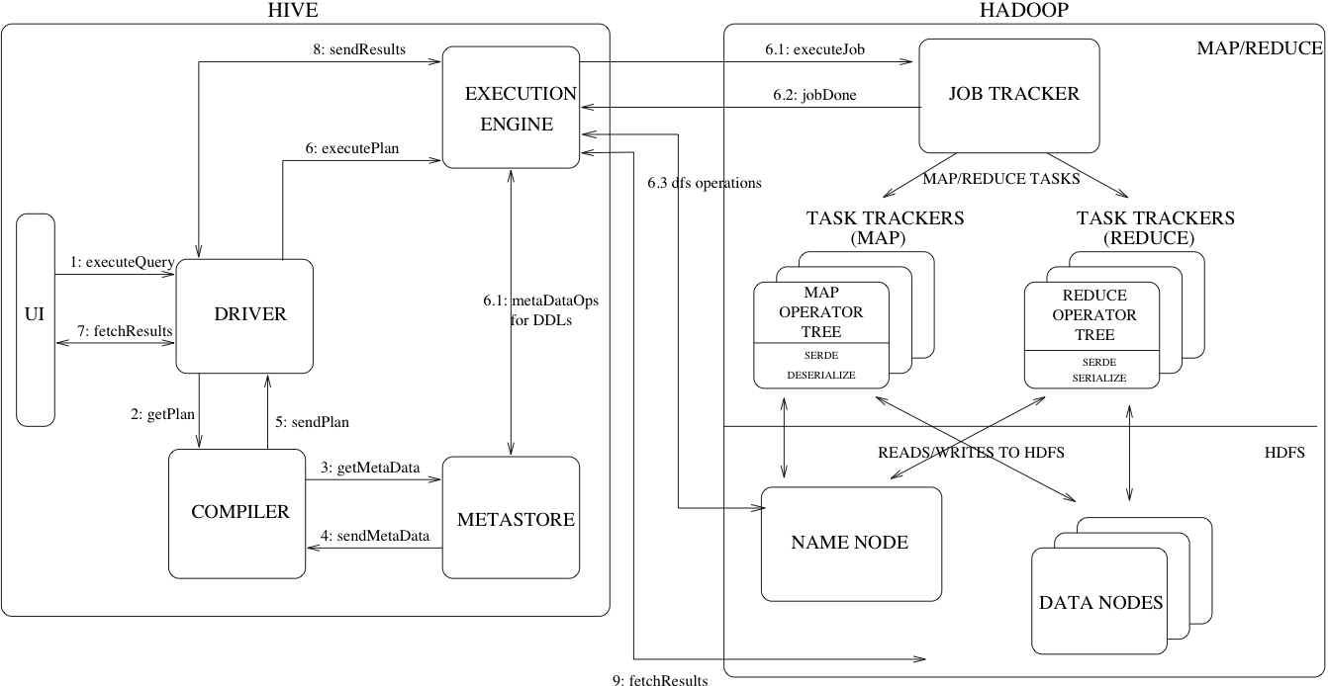
Hive Architecture

Slide 11
Hive Tables
Every table will be created as a directory
Managed/Internal Table
On dropping a table, the data gets deleted and there is no copy of data on HDFS
This means on creating internal table data gets moved from HDFS to Hive
External Table
On dropping an external table, the data does not get deleted from HDFS and only the metadata of the table gets deleted
External tables are just pointers to HDFS data

Slide 12
Partitions
Hive Partitioning dividing the large amount of data into number pieces of folders based on table columns value
Hive Partition is often used for distributing load horizontally, this has performance benefit, and helps in organizing data in a logical fashion
Should use PARTITIONED BY (COL1,COL2…etc) command while hive table creation

Slide 13
Cont..
Without Partitions
/user/hive/warehouse/<dbname>/<tablename>/file1.txt – Jan
/user/hive/warehouse/<dbname>/<tablename>/file2.txt – Feb
/user/hive/warehouse/<dbname>/<tablename>/file3.txt – Mar
With Partitions
/user/hive/warehouse/<dbname>/<tablename>/month =Jan → Only Jan data
/user/hive/warehouse/<dbname>/<tablename>/month = Feb → Only Feb data
/user/hive/warehouse/<dbname>/<tablename>/month = Mar → Only Mar data

Slide 14
Adv & Disadv of Partitions
Advantage
Distribute execution load horizontally
Faster execution of queries
Disadvantage
There is a possibility for creating too many folders in HDFS that is extra burden for Namenode metadata
Partition is not solving responsiveness problem in case of data skewing towards a particular partition value
No need to search entire table columns for a single record

Slide 15
Hive Queries (sample)
Creating Internal table
Hive>create table product(pid int, name String, price int)
> COMMENT ‘Product Details'
> ROW FORMAT DELIMITED
> FIELDS TERMINATED BY ','
> LINES TERMINATED BY '\n'
> STORED AS TEXTFILE;
Creating External table
Hive>create external table productnew(pid int, name String, price int)
> ROW FORMAT DELIMITED
> FIELDS TERMINATED BY ','
> LINES TERMINATED BY '\n'
> LOCATION "/newproducthive/";

Slide 16
Cont..
Loading data from local
load data local inpath '/home/user/product.csv' into table product;
Loading data from HDFS
load data inpath 'hdfs:/newhive/product.csv' into table productnew;

Slide 17
Reference
Links-
https://cwiki.apache.org/confluence/display/Hive/Home
https://cwiki.apache.org/confluence/display/Hive/Design
https://cwiki.apache.org/confluence/display/Hive/Home#Home-UserDocumentation

Slide 18
Assignment
Install Hive
Create internal and external table using partitions
Load data from hdfs
Perform join operation and write the output into another table

